Slide 1
Tableau Practices
A well-designed dashboard can align your organization's efforts, help uncover key insights, and speed up decision-making.
Use this topic for tips on best practices for creating effective dashboards in Tableau.

Slide 2
Know your Purpose & Audience
In addition to knowing what you're trying to say, it's important to know who you're saying it to.
1. Does your audience know this subject matter extremely well or will it be new to them?
2. What kind of cues will they need?
Thinking about these questions before you head into the design phase can help you create a successful dashboard.

Slide 3

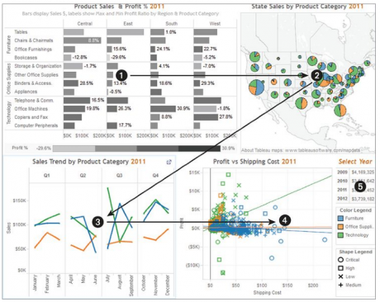
Design Approach
Most viewers scan content starting at the top left of a dashboard/page. Once you know your dashboard's main purpose, be sure to place your most important view so that it occupies or spans the upper-left corner of your dashboard.
Final Display Size – Fixed, Automatic or Range.
Limit the number of views - Too many views can also interfere with the performance of your dashboard after it's published.
Reduce the number of marks on the view.
Add Interactivity – Filters & Highlighters.
Use Actions to Filter instead of Quick Filter.
Use “Show Relevant Values”
Focus on Aesthetics (font, color, size, shapes, background)
Respect the space ( padding, border, containers)
Read More >>

Slide 4
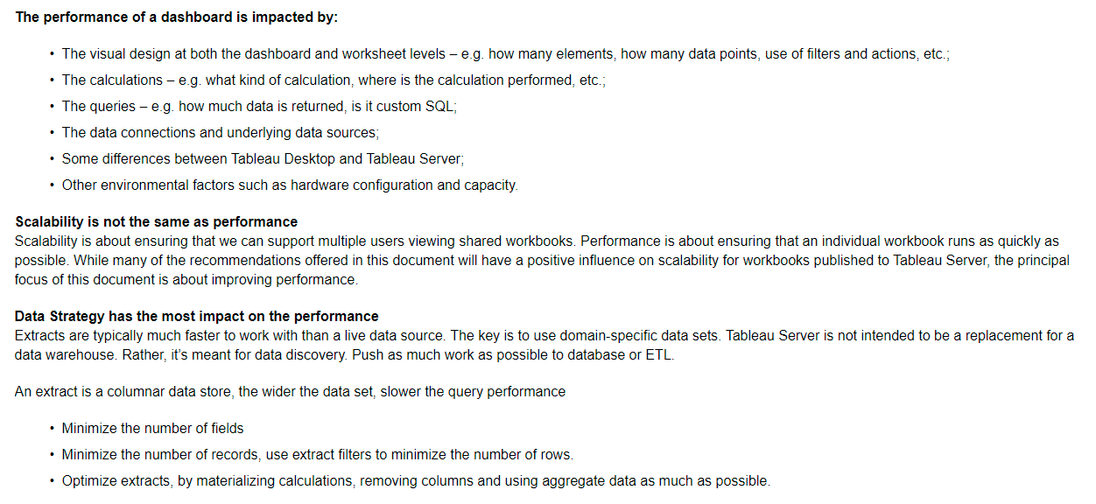
Efficient Workbook
Simple
Is it easy to create the workbook and will it be easy to maintain in the future?
Does it clearly communicate the message of the author and the data?
Flexible
Can the workbook answer multiple questions the users want to ask, or just one?
Does it engage the user in an interactive experience or is it simply a static report?
Fast
Does the workbook respond quickly enough for the users?
This could mean time to open, time to refresh or time to respond to interaction. This is a subjective measure but in general we want a workbook to provide an initial display of information and to respond to user interactions within seconds.
Read More >>

Slide 5
Tableau Server Performance
Use Published Data Source
Use Row Level Security (RLS)
Schedule Data Refresh during non-business hours
Prioritize Schedule refreshes.
Favor Incremental over Full refresh whenever possible.

Slide 6
Resources
Looking for Colors - https://coolors.co/
Looking for Vizzes - https://datavizcatalogue.com/

Slide 7


Expressiveness is displaying data accurately. Effectiveness is the ability of visualization to convey the meaning.
Mufaddal Haidermota
https://public.tableau.com/profile/max6387

